Slide 1

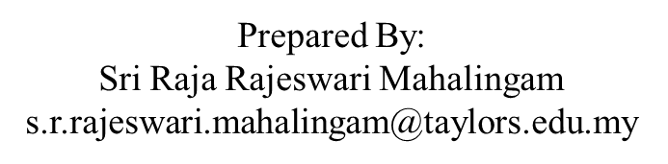
APPLICATION CHEMISTRY
A2 LEVEL
MATERIALS AND DESIGN
CHAPTER 3:
NANOTECHNOLOGY

Slide 2
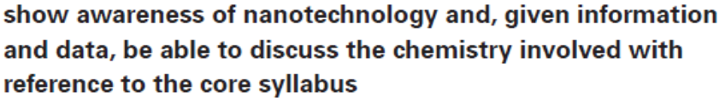
What you should know…

Slide 3
Nanotechnology
Nanotechnology has been described as “the science of the very small with big potential”.
“Very small” in this context means of an order of nanometres
One nanometre is 0.000000001 m.
It can be written as 1 nm or 1 x 10⁻⁹ m.
Atoms and molecules are nano- and picometre sized.
Science involving nano-sized particles is called nanoscience.

Slide 4
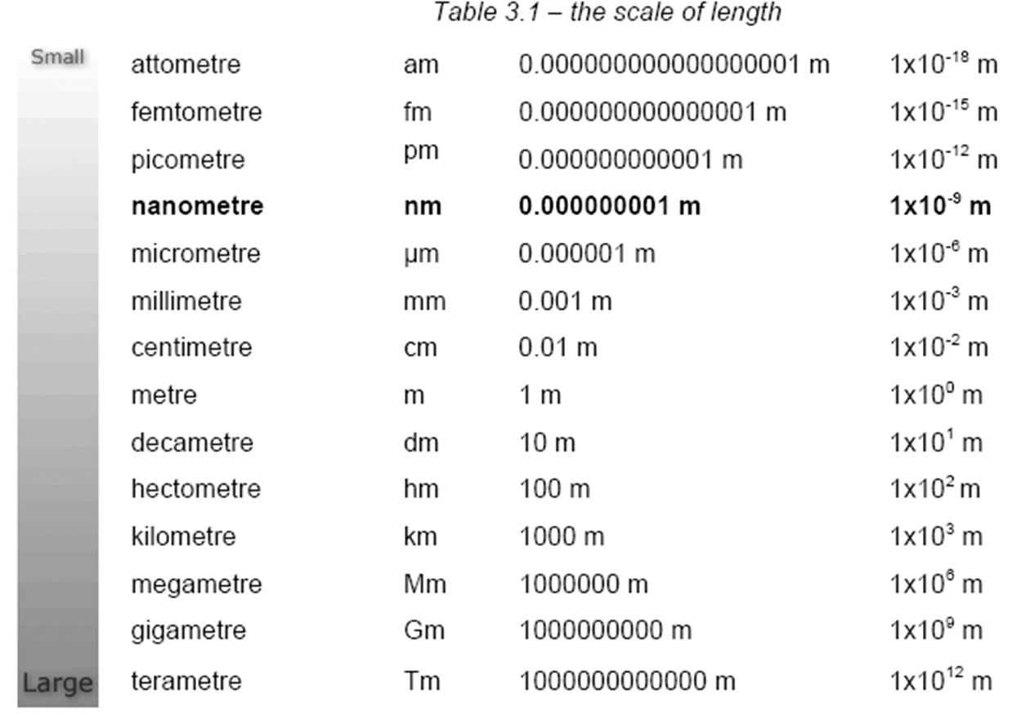
Nanotechnology

Slide 5
Buckyballs
Buckminsterfullerene, is composed entirely of carbon atoms.
Third allotrope of carbon
A total of 60 carbon atoms are present forming a sphere consisting of five-carbon and six-carbon atom rings arranged in the same pattern as a modern soccer ball.
It is just less than a nanometer in size.

Slide 6
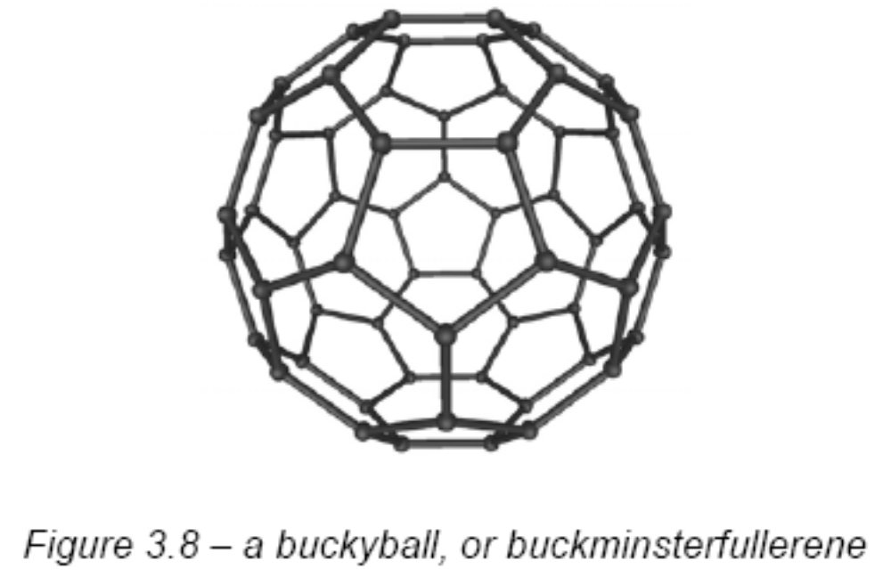
Buckyballs

Slide 7
Buckyballs
Buckminsterfullerenes were initially discovered in 1985 during experiments with carbon clusters in supersonic beams.
As well as C₆₀, other sized balls have been created.
Unlike other forms of carbon, fullerenes may be soluble, as shown in the photograph below.
C₆₀ is pink and C₇₀ is red in solution.

Slide 8
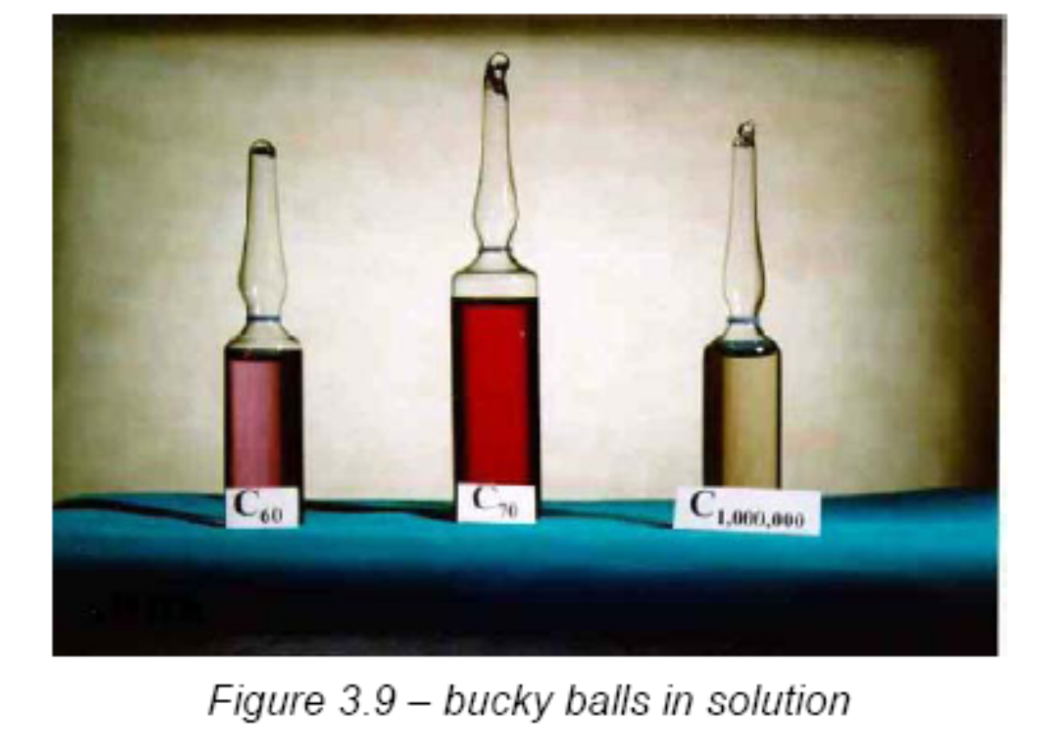
Buckyballs

Slide 9
Buckyballs
Buckyballs have unusual properties which led to a lot of excitement about their potential.
They:
  may be harder than diamond
  may be more slippery than Teflon
  may be insulators or conductors

Slide 10
Buckyballs
Buckyball can enclose an atom of another element inside itself.
This can be a reactive element or molecule such as a lanthanum atom.
The highly reactive atom becomes trapped – while it is protected by the carbon cage it cannot react, but as soon as the cage is removed it can react again.
The structure below shows a lanthanum atom in the centre of a buckyball.

Slide 11
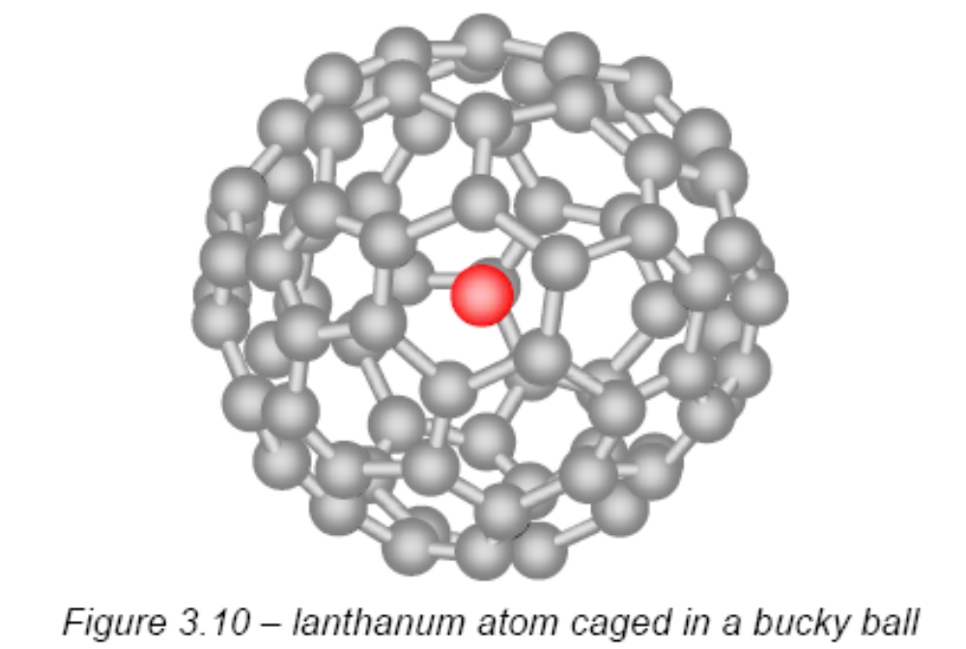
Buckyballs

Slide 12
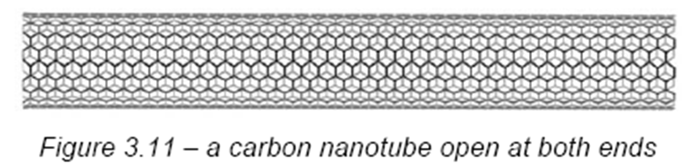
Carbon nanotubes
Cylindrical in structure and also resemble a rolled-up sheet of graphite, with the carbon molecules arranged in repeating hexagons.
They have a diameter of a few nanometers and can be open at both ends, sealed at one end or sealed at both ends.

Slide 13
Carbon nanotubes
Carbon nanotubes are ‘Mini but Mighty’, they are many times stronger than steel.
The mechanical (stiffness, strength, toughness), thermal and electrical properties of pure buckytube materials enable a multitude of applications, from batteries and fuel cells to fibres and cables to pharmaceuticals and biomedical materials.
They are found in the batteries of most laptop computers.

Slide 14
Carbon nanotubes
World’s smallest test tube - from carbon tubes
One end of the tube is closed by a fullerene cap that contains both pentagons and hexagons.
The tube has a volume of 10⁻²⁴ dm³.
The nanoscale test tube has various derivatives attached.
These could, for example, be immobilised enzymes enabling fast reactions in the synthesis of new drugs.
There are distinct advantages of carrying out these reactions on the nanoscale.

Slide 15
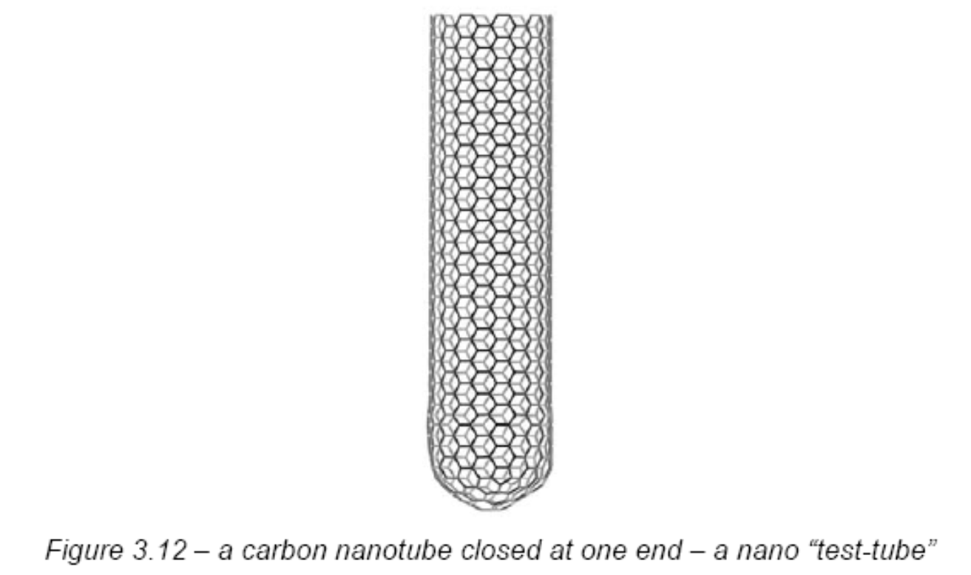
Carbon nanotubes

Slide 16
Carbon nanotubes
In a normal test tube, the particles have to collide to react and these collisions rely on random movement.
In many reactions not all the particles react, or unwanted side-products are produced
These problems result in reduced yield.

Slide 17
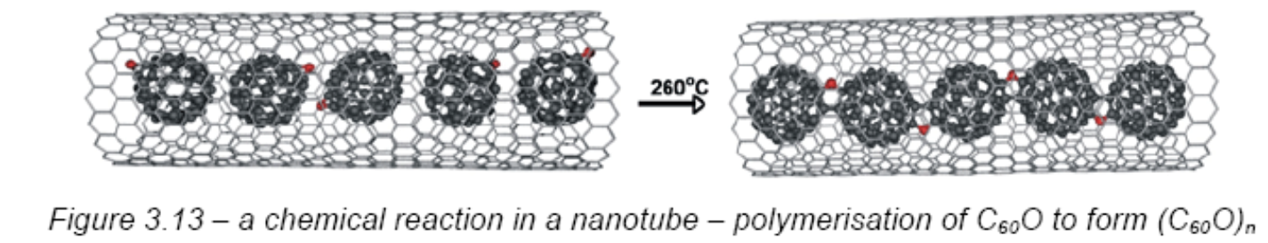
Carbon nanotubes
By contrast, a nanoscale reaction, where individual molecules are brought together, can have an exceedingly high yield.

Slide 18
Carbon nanotubes
Another kind of structure being developed involves
buckyball cages containing trapped atoms.
These buckyball cages are then entrapped inside a nanotube, rather like peas in a pod.
Purpose - to investigate the structure as an information storage display

Slide 19
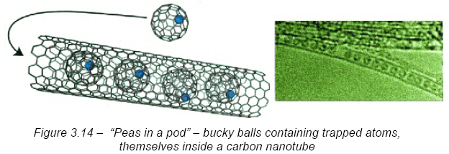
Carbon nanotubes

Slide 20
Supramolecular chemistry – making super-molecules
Supramolecular - “beyond the molecule”.
Molecules that recognise each other - same way that biological molecules such as enzymes recognise and bind other molecules,
Lehn, Cram and Pedersen created synthetic molecules called crown ethers that recognise and bind (form a complex with) metal ions.
Bind to each other by noncovalent effects, including hydrogen bonding and van der Waals forces.

Slide 21
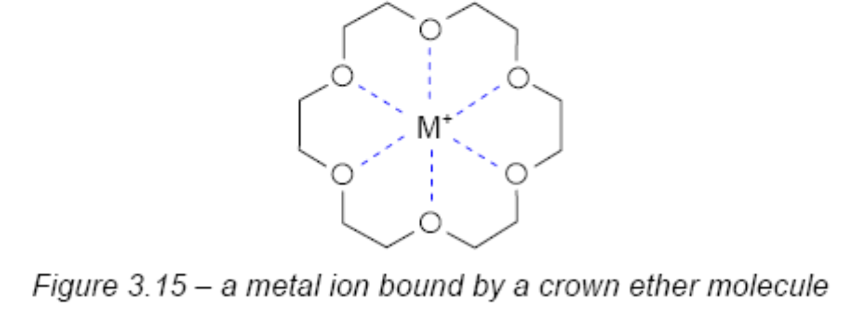
Supramolecular chemistry – making super-molecules
These super-molecules are being designed to be catalysts, to transport drugs, to transmit electricity and to harvest light, among many other things.

Slide 22
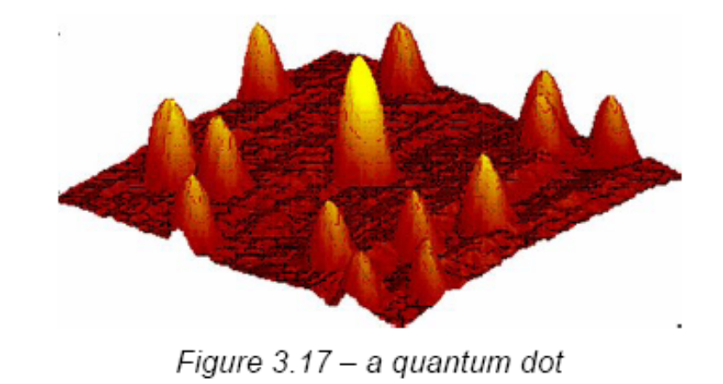
Quantum dots
A quantum dot is a nanocrystal made of semiconductor materials that are small enough to exhibit quantum mechanical properties.
Emitting photons one at a time.
based on quantum dot technology.
Quantum dots are devices that contain trapped electrons.

Slide 23
Quantum dots
They are made from semiconductor materials such as silicon and have dimensions that are typically between a few nanometres and a few microns.
The size and shape of these structures, and therefore the number of electrons they contain, can be precisely controlled

Slide 24
Quantum dots
Quantum dots – behave more like atoms than like the bulk material.
When excited, they emit light, and the dots can be tuned to emit light of a specific wavelength, and even to emit single photons.
Toshiba’s quantum-dot emitter reliably generates single photons on demand when excited by short optical pulses.

Slide 25
Quantum dots
Other nanotech application:
Kodak Ultima inkjet paper - "fix" the dyes in the bottom two layers. The top layer contains ceramic nanoparticles to further stabilize the image. Prints predicted to last for up to 100 years.
Sunscreens contain particles of titanium dioxide. In the sunscreens the particle size is close to nano-size. At this size it still reflects UV light but doesn’t give such a white appearance as larger particles.
Nanocomposites - made by grinding down clays or ceramics to a nano-sized powder. The powder is mixed with a polymer to form the material.

Slide 26
Instruments
Atomic Force Microscope (AFM) together with the Scanning Tunnelling Microscope (STM).
These instruments allow us to see individual atoms on surfaces.

Slide 27
Promise and possible problems of nanotechnology
Many applications only require very small amounts of nanoparticles, so this reduces risks considerably.
However some uses involve large quantities, for example sun screens.
Large scale manufacture can carry the same risk of explosion as production of other materials which have a small particle size and hence large surface area

Slide 28
PAST YEAR QUESTIONS

Slide 29
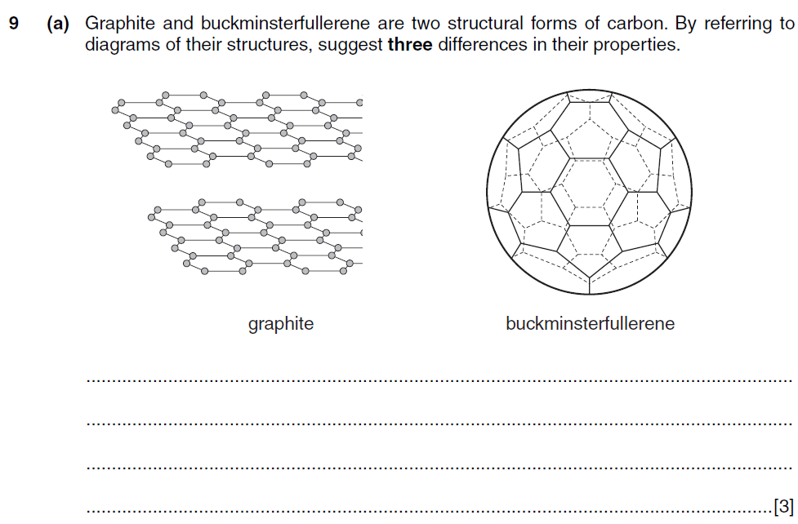


Slide 30
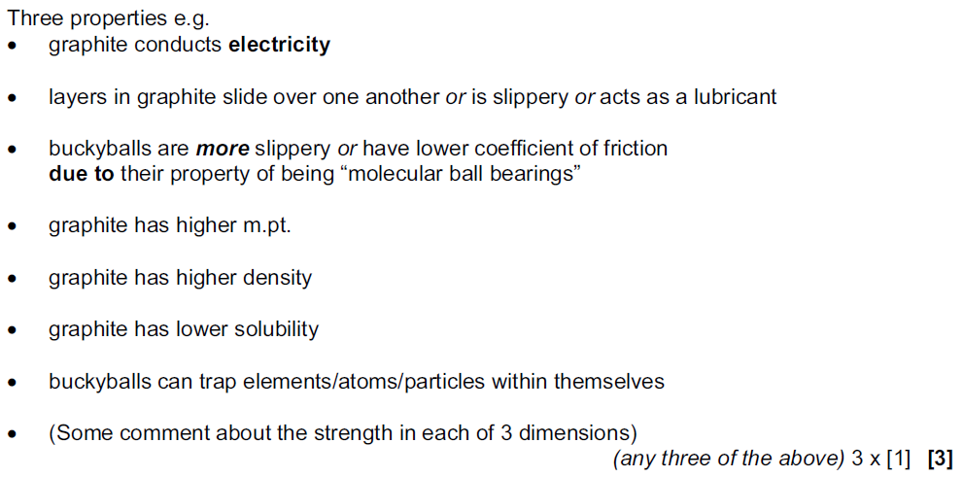

Slide 31
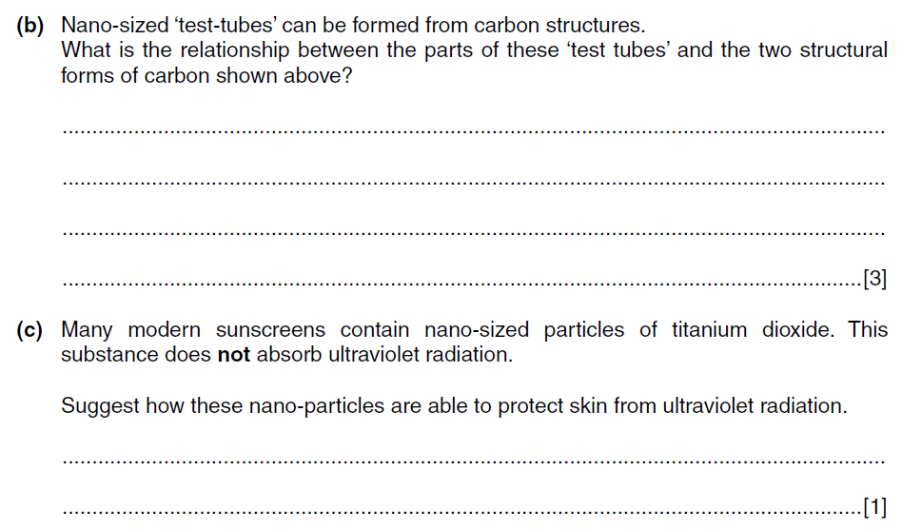
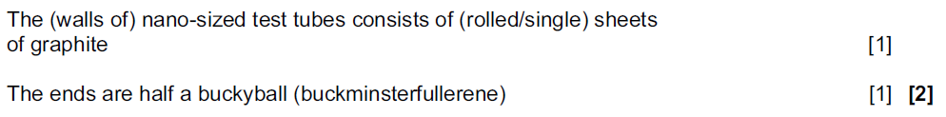

Slide 32
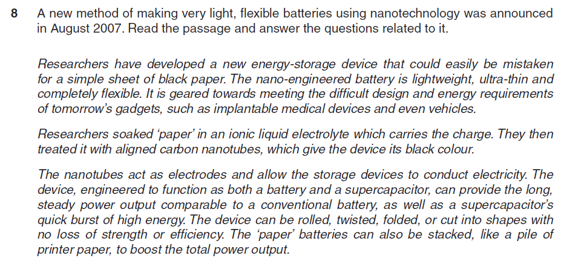


Slide 33
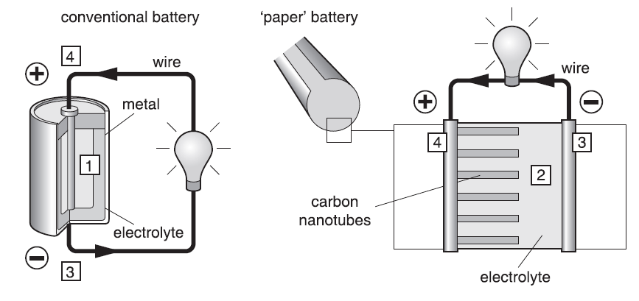

Slide 34
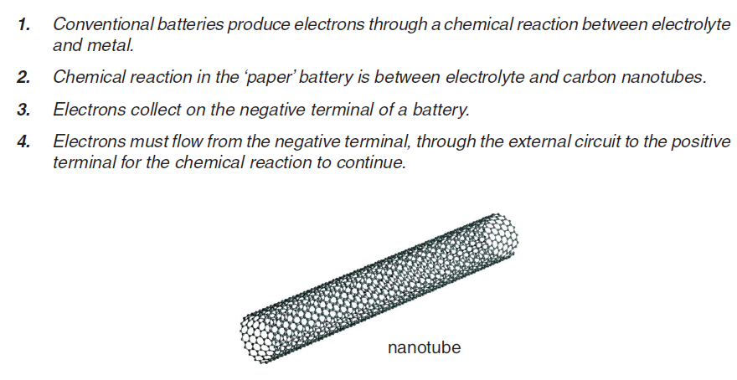

Slide 35
